Slide 1
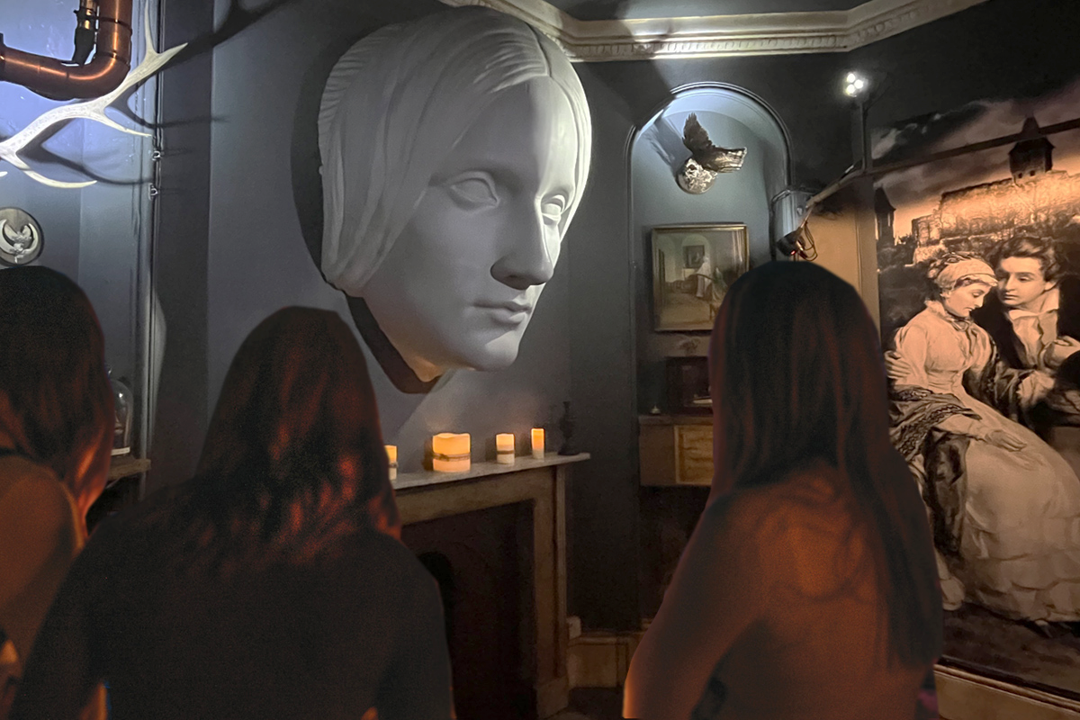
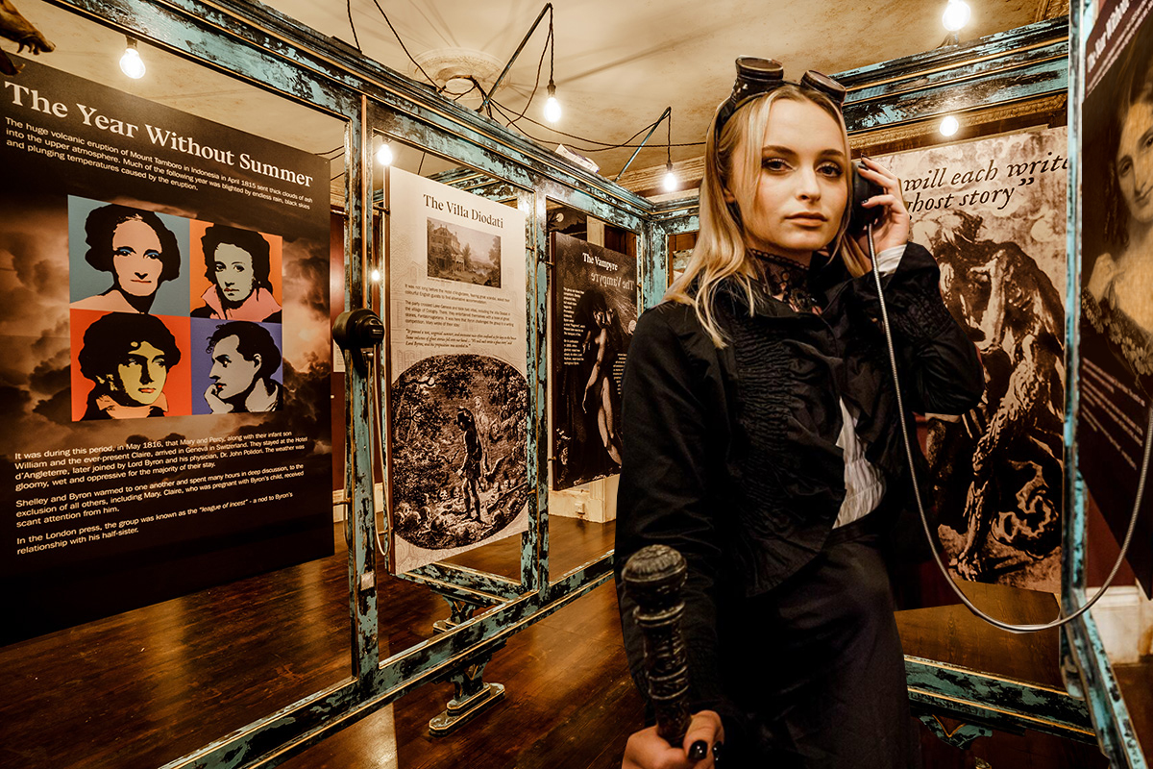
Discover Mary Shelley’s House of Frankenstein in Bath, an award-winning, multi-sensory museum located in a 300-year-old Georgian townhouse. The museum explores Mary Shelley’s life and time in Bath, her turbulent relationship with poet Percy Bysshe Shelley and their connections with contemporaries such as Lord Byron. Through immersive exhibits, visitors learn how her experiences shaped the writing of Frankenstein and examine the novel’s lasting cultural impact. The attraction also features themed Escape Rooms, offering an interactive extension to the museum experience.
MARY SHELLEY’S HOUSE OF FRANKENSTEIN
Travel Trade Information for 2026/27
  Address
  37 Gay Street Bath, BA1 2NT
  What3Words Locator
  Flips.Bottom.Traded
  Opening/Operating Times
  Open daily:
  Mon – Friday 11am – 4pm
  Weekends open until 5.30pm
  Extended opening for UK holidays
  Trade Information
  Suitable for families with children from 12 years.
  Not suitable for wheelchair users.
  Pricing
  Adults £17.95
  Children £14.50
  (please contact us or commissionable rates)
  Payment
  Due 30 days post visit. Clients will be invoiced.
  Best Time To Visit
  Weekdays less busy than weekends.
  Average time on site
  45-60 minutes
  Min & Max Numbers
  Up to 50 pax
  Upsells available
  VIP Guided Tours with founder.
  Mary Shelley Bath theatrical Walking Tour with Museum entry.
  Private Hire of Museum.
  Escape Rooms & Museum.
  Escape Games & Museum.
  Celebrator Party Packages.
  Restaurant add-ons.
  City Sight Seeing bus tours.
Bath is the birthplace of the world’s first sci-fi novel, Frankenstein, written here in 1816 by 18-year-old Mary Shelley. Critics were outraged a young woman had created such a radical story.
Mary lived in Bath with her husband, the notorious romantic poet, Percy Bysshe Shelley, and pregnant stepsister Claire Claremont in 1816-1817.
Claire’s illegitimate daughter with Lord Byron, Allegra Byron, was born in Bath in 1817 — adding to the city’s literary scandal.
Published in 1818, Frankenstein predates the first film adaptation by 92 years. Guests can see the 1910 Edison Studios silent film on display at the Museum.
While Mary’s original home no longer exists, a commemorative plaque marks the site just five minutes away. The Museum itself is a 300-year-old Georgian townhouse, authentically reflecting the period of this revolutionary story.
Vicki Smith / Charlotte Mullen / Tori Hilleard
CHESHIRE
Bookings: 01225 551542
Enquiries & Bookings: info@houseoffrankenstein.com

